Slide 1
Online Shopping Website
Built with MERN Stack
Name: M.Shaheer
Final Internship project

Slide 2

Introduction
Why need an ecommerce platform
Persistent identity with account not just session
A cart that survives across visits
A checkout that produces an immutable, auditable record
Discount logic that doesn't break pricing history
An admin layer to operate the store

Slide 3

Feature List
JWT authentication: register, login, forgot/reset password
Product catalog: keyword search, category filter, price range, 3 sort modes
Cart: add/update/remove with live stock enforcement against MongoDB
Coupon validation with percentage discounts and expiry dates
Checkout: converts cart → permanent order record
Order history with per-order line-item detail
Admin dashboard: create, edit, delete products
Dark mode with persisted preference

Slide 4










Tech Stack
Client
Server
Database
React 18
React Router 6
Vite
Node.js
Express 5
Mongoose Atlas/
MongoDB
Auth
Deployment
Testing & Version Control
JSON Web Tokens
bcrypt
Vercel (for client)
Railway (backend)
Postman
Git/Gihub

Slide 5
System Architecture
React Client (Vercel static build)
HTTPS + JSON, JWT in Authorization header
Express API (Hosted on Railways)
MongoDB Atlas
Client and API are both independently deployed from a single monorepo

Slide 6
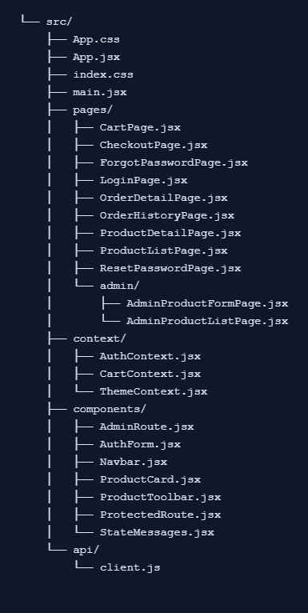
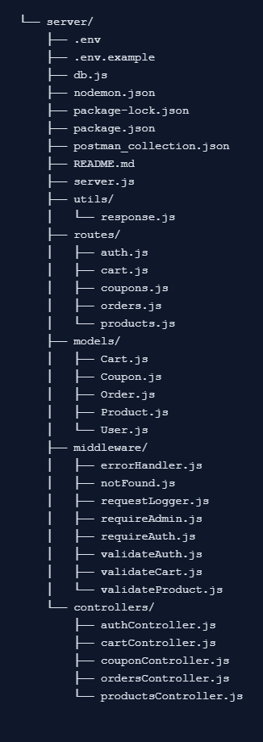
File Heirarchy

Slide 7
Data Model
 | Collection | Key Fields | References
1 | User | email, passwordHash, role | -
2 | Product | name, price, category, stock | -
3 | Cart | items[] | -> User , ->Product
4 | Coupon | code, discountPercent, expiresAt | -
5 | Order | items[], subtotal, total, status | -> User , ->Product

Slide 8
API Design
There are 19 REST endpoints across 5 resources:
Cart [4]
Get
Add item
Update quantity
Remove item
Auth [5]
Login
Register
Forgot Password
Me
Reset Password
Products [6]
List
Get one
Create/Replace/Update/Delete (admin)
Order [3]
Get one
Checkout
List history
Coupon [1]
Validate

Slide 9
Authentication Flow
Register: password → bcrypt hash (10 rounds) → stored → JWT signed and returned
Login: bcrypt.compare against stored hash → JWT signed and returned Every protected request: Authorization: Bearer <token> → verified server-side on every call, no session state stored
Forgot/Reset Password: crypto-random token, hashed before storage, 30-minute expiry

Slide 10
Security Measures
Passwords hashed with bcrypt -> plaintext never touches the database
JWT secret generated via crypto.randomBytes, stored only in environment variables; never commited
Server-side validation on every write endpoint, independent of client-side
Admin routes require both a valid token and an explicit role check
CORS restricted to an explicit origin allow-list, not wildcarded

Slide 11
Testing
16 documented test cases 8 normal-path, 8 error-path
What they Covered
registration/login/password-reset edge cases
1
admin authorization boundaries
2
cart referential-integrity edge cases (deleted products, stock limits)
3
·coupon validation ·
4
checkout on an empty cart
5
order isolation between different users
6
front-end and back-end route protection tested independently
7

Slide 12
Limitations & Future Roadmap
Planned next:
Real email service integration (Nodemailer / transactional API)
Product image uploads, pagination for large catalogs
Refresh-token based session persistence
Current limitations:
Password reset is dev-mode only (no real email delivery)
No refresh-token flow expired sessions require a full re-login
Serverless cold starts add latency after inactivity

Slide 13
THANK YOU

